Slide 1
Defender for IoT
100.2 Defender for IoT Architecture Overview

Slide 2
Agenda
Market Drivers
IoT & Industrial IoT Challenges for CISOs
Defender for IoT Architecture
Triton Industrial IoT Attack

Slide 3
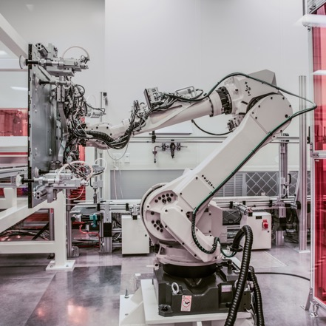

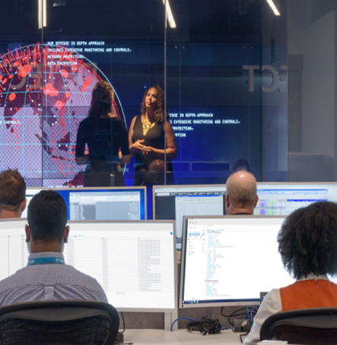
Why IoT/OT cybersecurity is now a board-level concern (OT = Operational Technology)
Digital transformation & IT/OT connectivity have significantly expanded the attack surface
OT cyberattacks target industrial production, impacting revenue & safety
Enterprise SOCs today have virtually no visibility into their IoT/OT risk

Slide 4





Industrial cyberattacks = financial risk
Honda, Nissan and Renault were forced to stop production at plants in North America, Europe, and Asia (WannaCry) … Norsk-Hydro lost $70M (LockerGoga) … losses due to NotPetya include:
$870
MILLION COST
$400
MILLION COST
$300
MILLION COST
$129
MILLION COST
$188
MILLION COST
… and more?
PHARMA
LOGISTICS
LOGISTICS
LYSOL
CADBURY CHOCOLATE
https://www.wired.com/story/notpetya-cyberattack-ukraine-russia-code-crashed-the-world/
Notes:
https://www.forbes.com/sites/peterlyon/2017/06/22/cyber-attack-at-honda-stops-production-after-wannacry-worm-strikes/#5b59debe5e2b
https://threatpost.com/maersk-shipping-reports-300m-loss-stemming-from-notpetya-attack/127477/
http://securityaffairs.co/wordpress/62085/malware/maersk-notpetya-losses.html
https://www.helpnetsecurity.com/2017/08/17/notpetya-losses/
http://www.securityweek.com/notpetya-attack-costs-big-companies-millions
http://gcaptain.com/corporate-earnings-feel-impacts-of-notpetya-cyber-attack/
https://www.wsj.com/articles/merck-swings-to-loss-as-cyberattack-hurts-sales-1509107269 ($175M clean-up costs, $130M lost sales, $240M in reduced revenue due to Gardasil)

Slide 5

Top Industrial and IoT Challenges for CISOs
IT & OT are converging to support the business
“Security by obscurity” & “air-gap” concepts not relevant anymore
Perimeter security insufficient to address modern threats (sophisticated malware, targeted attacks, malicious insiders)
IoT devices can not support agents and other security controls
IoT devices are dramatically increasing the attack surface for enterprises
Lack of visibility by IT security team
Plants typically don’t know which devices they have — or how they’re connected
IoT devices are being deployed and connected to enterprise networks without and security controls
Industrial networks are complex, heterogeneous & insecure by design
Non-IT protocols & non-standard devices (PLCs, DCUs, etc.)
Legacy unpatched Windows systems
Legacy insecure protocols (weak authentication, serial wrapped in IP, etc.)
Lack of qualified ICS security personnel
Need to supplement in-house teams with external expertise

Slide 6

Defender for IoT Within Microsoft’s Security Portfolio
Deliver end-to-end security across your organization
SIEM
Multi-cloud
Azure Sentinel
Third party and partners
Email/docs
Endpoints
SQL
VMs
Containers
Identity
Apps
Apps
IoT
Network
Microsoft Threat Protection
Azure Security Center
Notes:
Talk track:
To help empower your defenders, Microsoft’s cloud-based, threat-protection solution connects the dots across vectors to deliver rich, actionable insights that strengthen your organization’s security. Built on an expansive cloud ecosystem that powers scalability, pattern recognition, and signal processing to detect threats at speed, it also correlates these signals accurately to help you understand how the threat entered your environment, what it affected, and how it currently impacts your organization. It’s backed by the massive volumes of threat signals we process daily to provide meaningful insights, and it correlates signal to determine the full scope and impact of a threat across the enterprise. Our threat protection solution consists of these solutions:
Microsoft Threat Protection: Best-in-class products enable you to proactively hunt across your Microsoft 365 data to search for breaches or gain a better understanding of your data to build custom detection and remediation tools. Microsoft Threat Protection enables you to visualize and remediate across your Microsoft 365 environment from a single, integrated dashboard.
Azure Security Center (ASC): ASC provides industry-leading threat intelligence to help you gain deep insights into your cloud workloads and help protect against threats. ASC provides a competitive, cloud-native cloud workload protection platform (CWPP) for Windows and Linux servers, containers, and serverless workloads that have been widely adopted across Azure and hybrid customers.
Microsoft Azure Sentinel: Finally, we also recognize that protecting your enterprise means more than having insight into threats to your Microsoft assets—you need to protect every asset. Many customers have a security information and event management (SIEM) solution for this very reason, but SIEM implementations have not always been successful due to their significant on-premises costs and challenges in prioritizing the large volume of signal they collect. That’s why we reimagined the SIEM and Security Orchestration, Automation and Response (SOAR) tool to introduce Microsoft Azure Sentinel, a new cloud-native solution that provides intelligent security analytics at cloud scale for your entire enterprise. Azure Sentinel makes it easy to collect security data across your entire hybrid organization from devices, users, apps, servers, and any cloud. It uses the power of artificial intelligence to ensure you identify real threats quickly. At the same time, Azure Sentinel offers limitless cloud scale and speed, and scales automatically to address your needs.
Put together, these solutions provide comprehensive, end-to-end security across your organization.

Slide 7

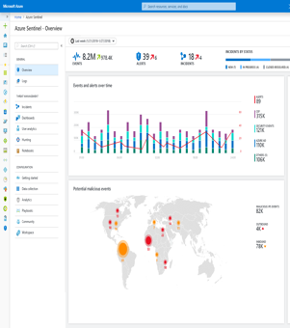
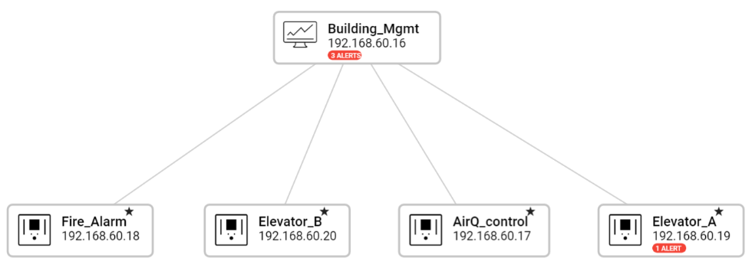
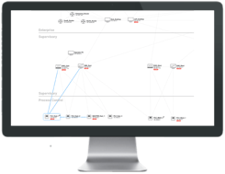




Simple, non-invasive deployment — network-layer monitoring
Sensor performs Deep Packet Inspection (DPI) using patented, IoT-aware behavioral analytics
SIEM/SOAR
Azure Security Center and/or local web console
Assets
Vulnerabilities
Threats
Alerts
Virtual or physical appliance
Application
TCP Application
IP TCP Application
Network
Packet Capture
Ethernet IP TCP Application
SPAN port
OT Network
OT Network
Notes:
CLICK IN SLIDE MODE TO START ANIMATION

Slide 8

Client Challenges Addressed With Defender for IoT
IoT/OT Asset Discovery
Operational Efficiency
What devices do we have & how are they communicating — so we can easily implement better segmentation & zero-trust policies?
How do we identify & rapidly eliminate inefficiencies from misconfigured or compromised networks/equipment?
Risk & Vulnerability Management
Unified IT/OT Security Monitoring & Governance
What are risks to our “crown jewel” IoT/OT assets — and how do we prioritize mitigation?
How do we leverage existing people, training & tools to centralize IT/OT security in our SOCs?
How do we demonstrate to auditors that we have a safety- and security-first environment?
Continuous IoT/OT Threat Monitoring, Incident Response & Threat Intelligence
How do we know if we have any IoT/OT threats in our network right now — and how do we quickly respond to them?

Slide 9
The TRITON attack on a petrochemical facility “had a deadly goal … it was not designed to simply destroy data … it was meant to sabotage the firm’s operations and trigger an explosion.”
https://www.nytimes.com/2018/03/15/technology/saudi-arabia-hacks-cyberattacks.html

Slide 10
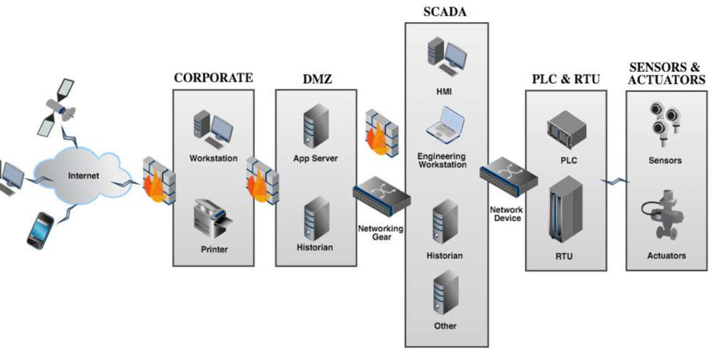

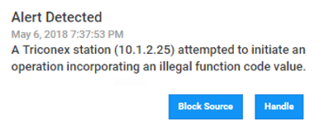
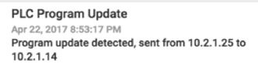
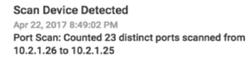
TRITON Kill Chain Example
Windows Defender Advanced Threat Protection & CyberX simultaneously detect suspicious RDP access from IT to OT network — alerts converged in Azure Sentinel incident
Deploy PC malware
1
2
3
4
Steal credentials
Install RAT in safety PLC
Disable safety PLC & launch 2nd cyberattack
TriStation Protocol
L4
L3
L1
L0
L2
Notes:
https://www.darkreading.com/attacks-breaches/triton-trisis-attack-was-more-widespread-than-publicly-known/d/d-id/1333661

Slide 11
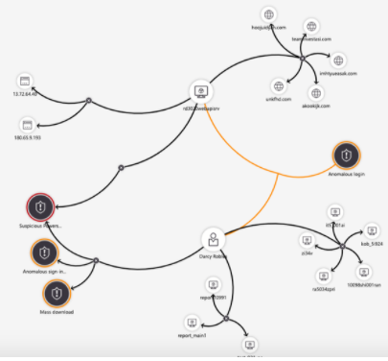
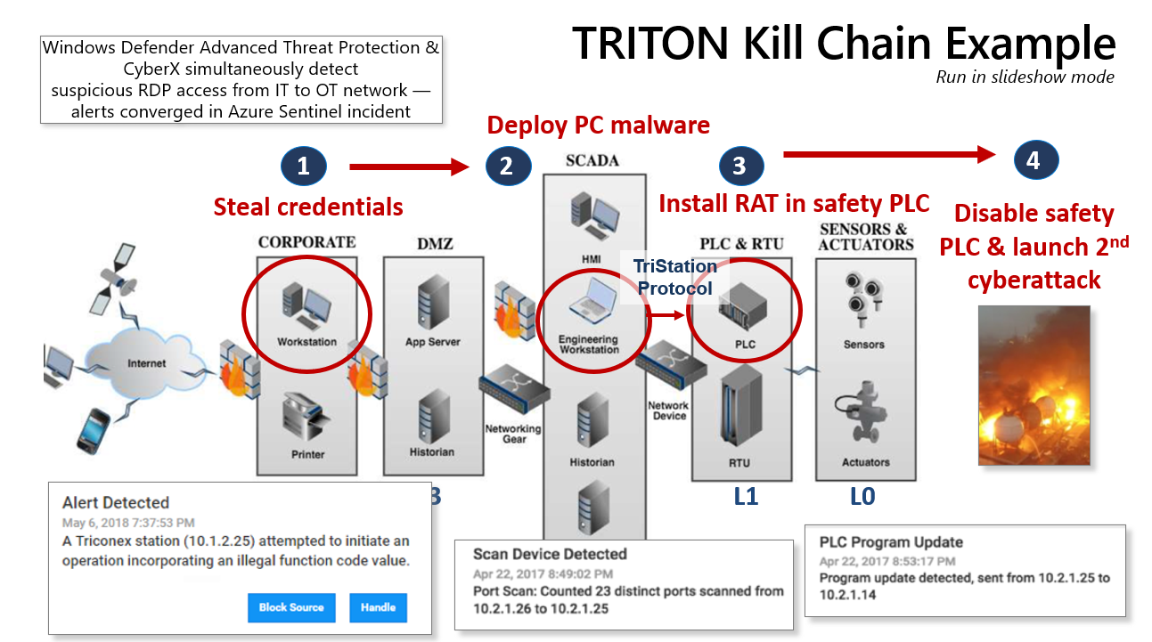
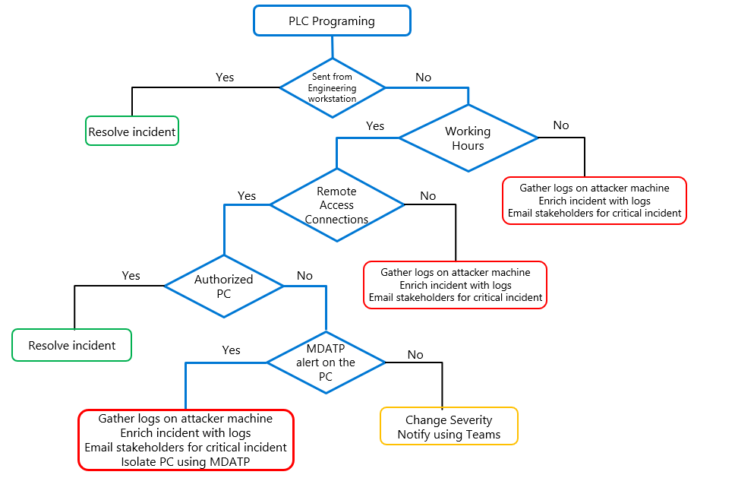
IT and OT Convergence: CyberX Forwards OT Alerts To Sentinel
Azure Sentinel
Traditional IT
Security Alerts
CyberX forwards
IoT/OT alerts to
Azure Sentinel
CyberX OT Playbooks

Slide 12

How CyberX Supports the NIST Cybersecurity Framework (CSF)
Threat
Insight
Threat Prevention
Threat Detection
Threat Response
Threat Recovery
Identify
Prevent
Detect
Respond
Recover
Asset discovery
Network topology mapping
Identifying unauthorized remote access & weak credentials
Automated OT threat modeling
OT vulnerability management & risk mitigation
Native integration with firewalls & NACs
Continuous OT monitoring with patented behavioral anomaly detection
Deep forensic & threat hunting tools
Native apps for SIEM integrations
Integration with IT Service Management (ITSM) and orchestration tools (SOAR)
Automated reporting to stakeholders
Alerting on failed backups
OT threat intelligence feeds

Slide 13


Flexible deployment options
100% On-Premises
On-premises sensors connected to on-premises SIEM (Splunk, etc.)
Hybrid
On-premises sensors managed locally
& connected to cloud-based SIEM (e.g., Azure Sentinel)
Cloud
On-premises sensors managed via Azure Security Center and connected to Azure Sentinel

Slide 14



Summary: Why CyberX
Easy to deploy
No agents, rules or signatures — leverages machine learning & IoT/OT-aware behavioral analytics
Supports all major industrial protocols & equipment
GE, Rockwell, Schneider, Emerson, Siemens, ABB, Yokogawa, etc. (IT security monitoring tools are blind to these protocols)
Integrates with Azure Security Center & Azure Sentinel plus existing security stacks (Splunk, etc.)
Proven in large & complex enterprise environments
Addresses key gap for CISOs who currently have no visibility into their IoT & Operational Technology (OT) risk
Notes:
Talk track:
When your assets are on the line, your defenders need tools that enable them to remediate effectively. Here's how Microsoft is helping to empower your security posture.
Microsoft’s AI processes thousands of low-fidelity signals we collect across the environment to find the smaller number of high-fidelity signals that require immediate critical action. In our security information and event management (SIEM) product alone, we have seen a noise reduction of 90 percent because we escalate only the most critical issues—the top 10 percent—to security professionals to address.¹
AI also plays a critical role in finding threats that might not have been immediately obvious to your security team. We train our AI models on attack patterns at global scale, based on the extensive work our security operations team has undertaken to protect our customers. You can see the full scale of the attack by using AI to link into a clear chain of what would have historically been individual signals. This approach rapidly accelerates your ability to understand an attack and address the issue across multiple assets—before the risk grows.
We can also help defenders work more efficiently by moving beyond repetitive tasks. With automation, you can remediate in-flight issues far faster and integrate with your standard ticketing systems, such as ServiceNow.
If, for example, we discover a threat in an email and watch the threat move laterally into organizations, we can protect users by leveraging integration with identity services as well as protect endpoints by automatically taking action. These actions prevent ransomware from moving laterally to infect other endpoints, for example, or providing conditional access to endpoints and users to restrict access to anything and anyone determined to have been compromised. AI-powered playbooks dynamically harden the environment through automated workflows.
Threat and vulnerability management, a component of our endpoint protection solution, monitors, prioritizes, and automatically remediates OS vulnerabilities and misconfigurations, as well as Microsoft, third-party, and corporate internal applications. By leveraging management tools such as Intune and SCCM, this solution can also bridge the gap between Security and IT ops teams. It automatically deploys patches for the most recent vulnerabilities or upgrades affected applications to a non-vulnerable version.
Finally, we know that sometimes you need to supplement your team with additional resources. We recently introduced the Microsoft Threat Experts program, a managed hunting service that provides security operation centers with expert-level monitoring and analysis to help them make sure they don’t miss critical threats in their unique environments.
Microsoft’s technology and expertise empowers security professionals to do what they do best, and automates the rest for the greatest impact.
1. Source: Microsoft Internal https://azure.microsoft.com/nl-nl/blog/introducing-microsoft-azure-sentinel-intelligent-security-analytics-for-your-entire-enterprise/

Slide 15
Thank You

Slide 16
Compliance Regulations, Industry Frameworks & Agency Guidance
NSA/CISA Recommendations: Immediate Actions to Reduce Exposure Across Operational Technologies and Control Systems (July 23, 2020)
North American Energy Reliability — Critical Infrastructure Protection (NERC-CIP)
NIST CSF for Critical Infrastructure
NIST Recommendations for ICS Security
Network & Information Security (NIS) Directive: European Union
OG86: UK Health & Safety regulation for Industrial Automation & Control Systems (IACS)
Cybersecurity Maturity Model Classification (CMMC): US defense contractors

